Slide 1
Recruiting and Communication within the Team

Slide 2
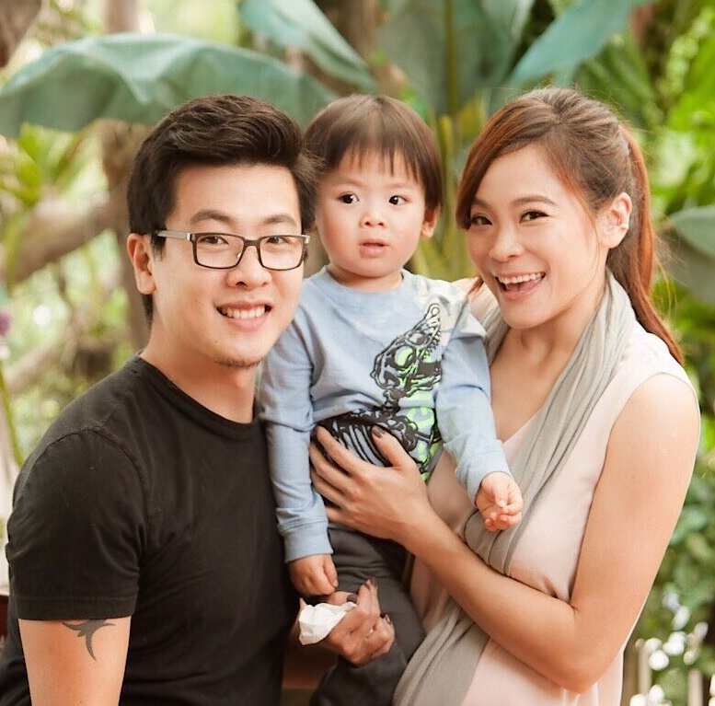
Executive Field
Vice President four-week pay cycle
US$45,000 – US$63,000
Stacy Tung

Slide 3
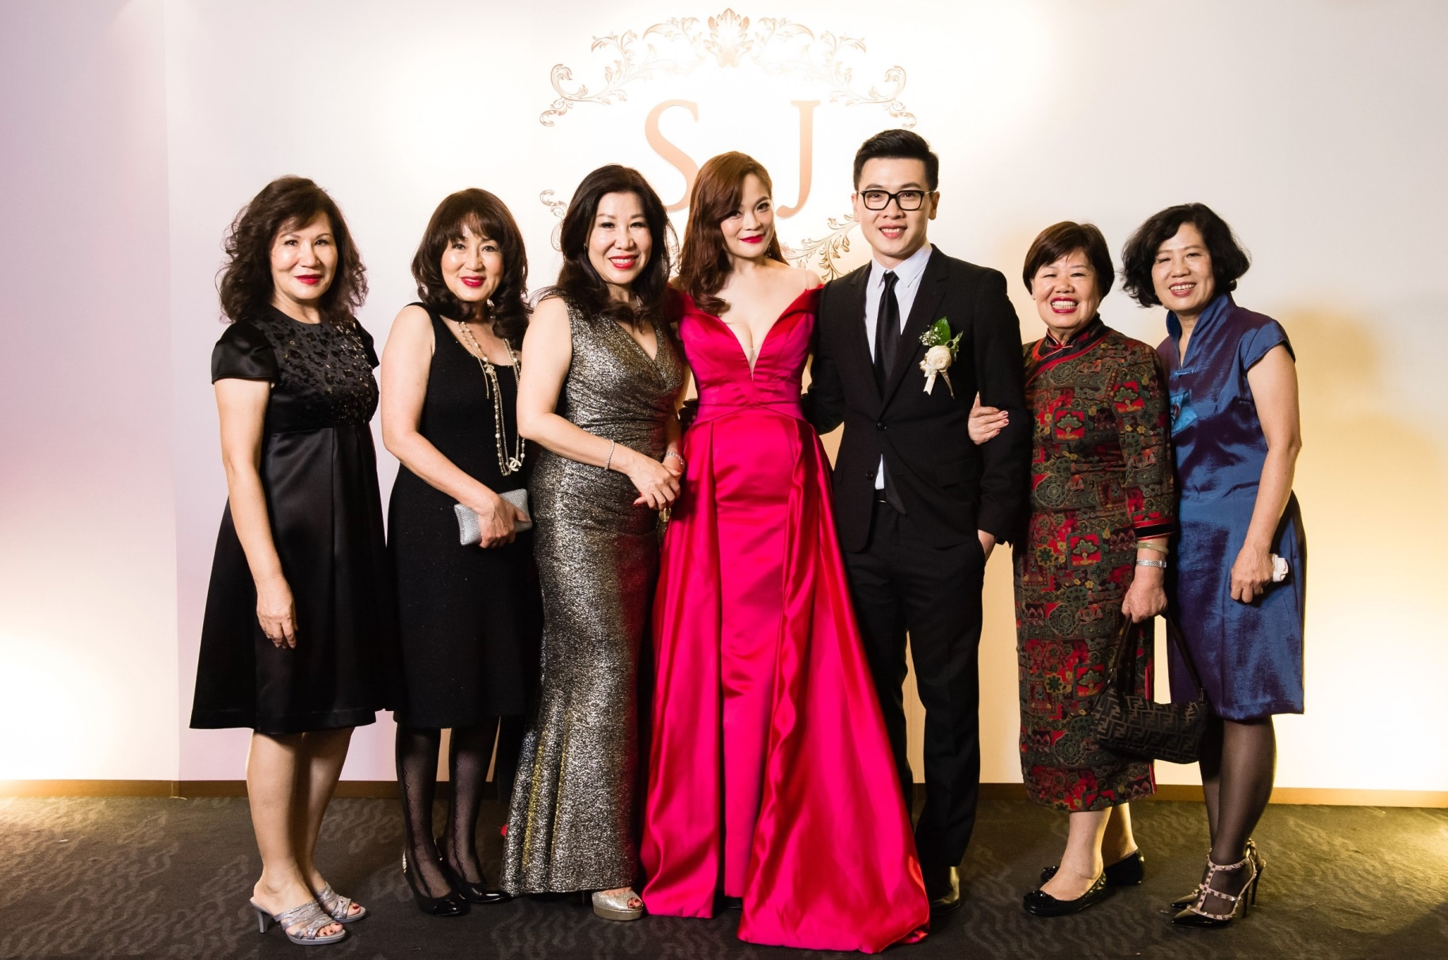

Slide 4
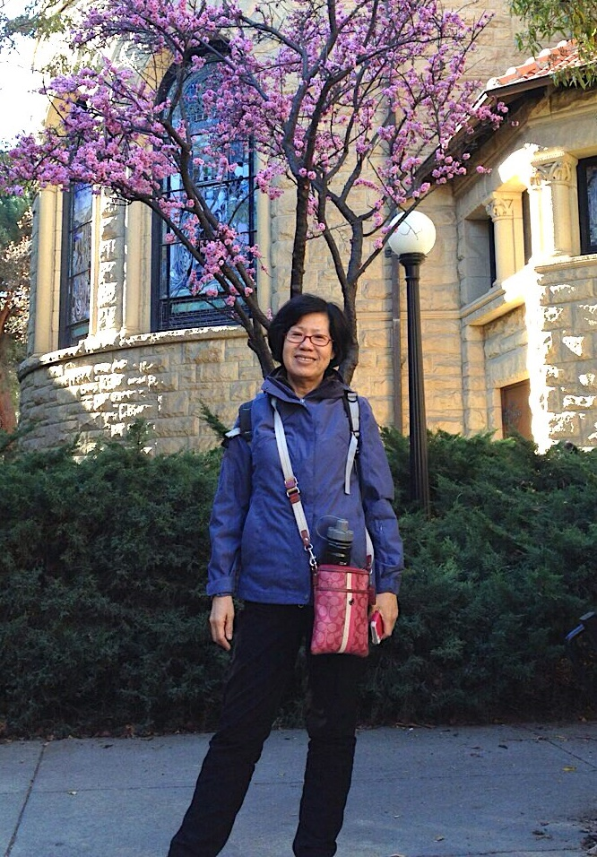
Professional Coordinator four-week pay cycle
US$4500 – US$7500
席幼鳳

Slide 5
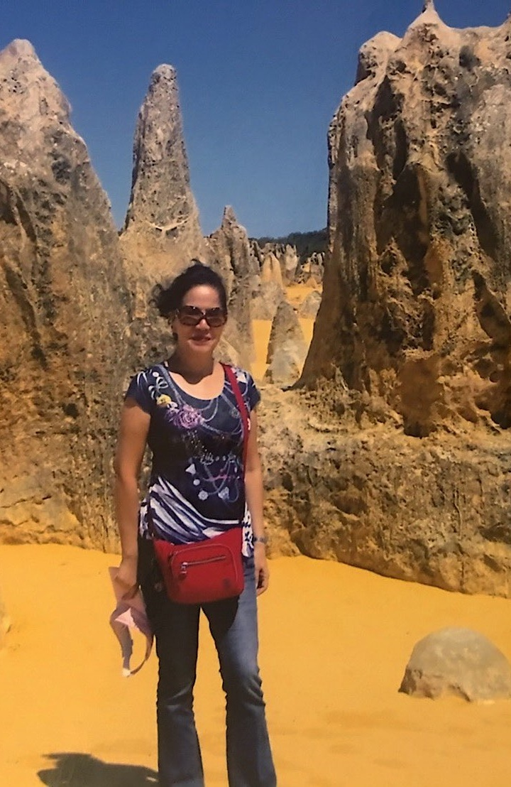
National Supervising Coordinator four-week pay cycle
US$10,000 - US$15,000
席海南

Slide 6
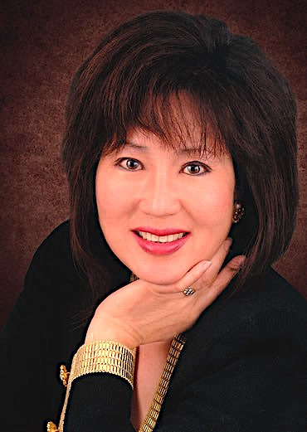
SENIOR EXECUTIVE FIELD VICE PRESIDENT four-week pay cycle
US$63,000 – US$81,000
Nina Hale (席南怡)

Slide 7
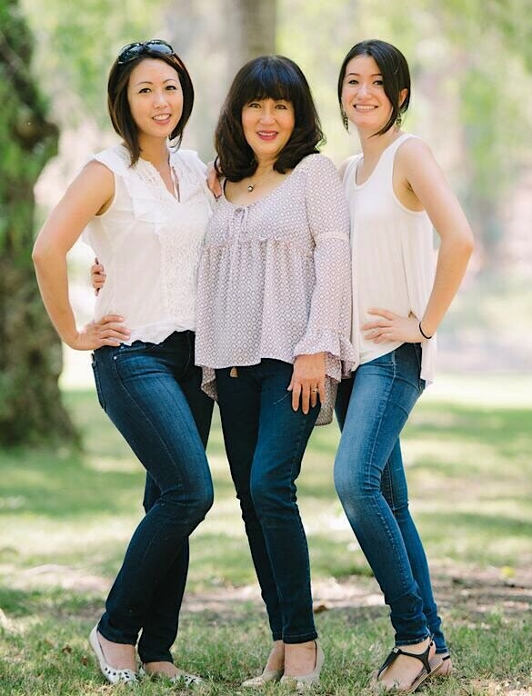

Slide 8
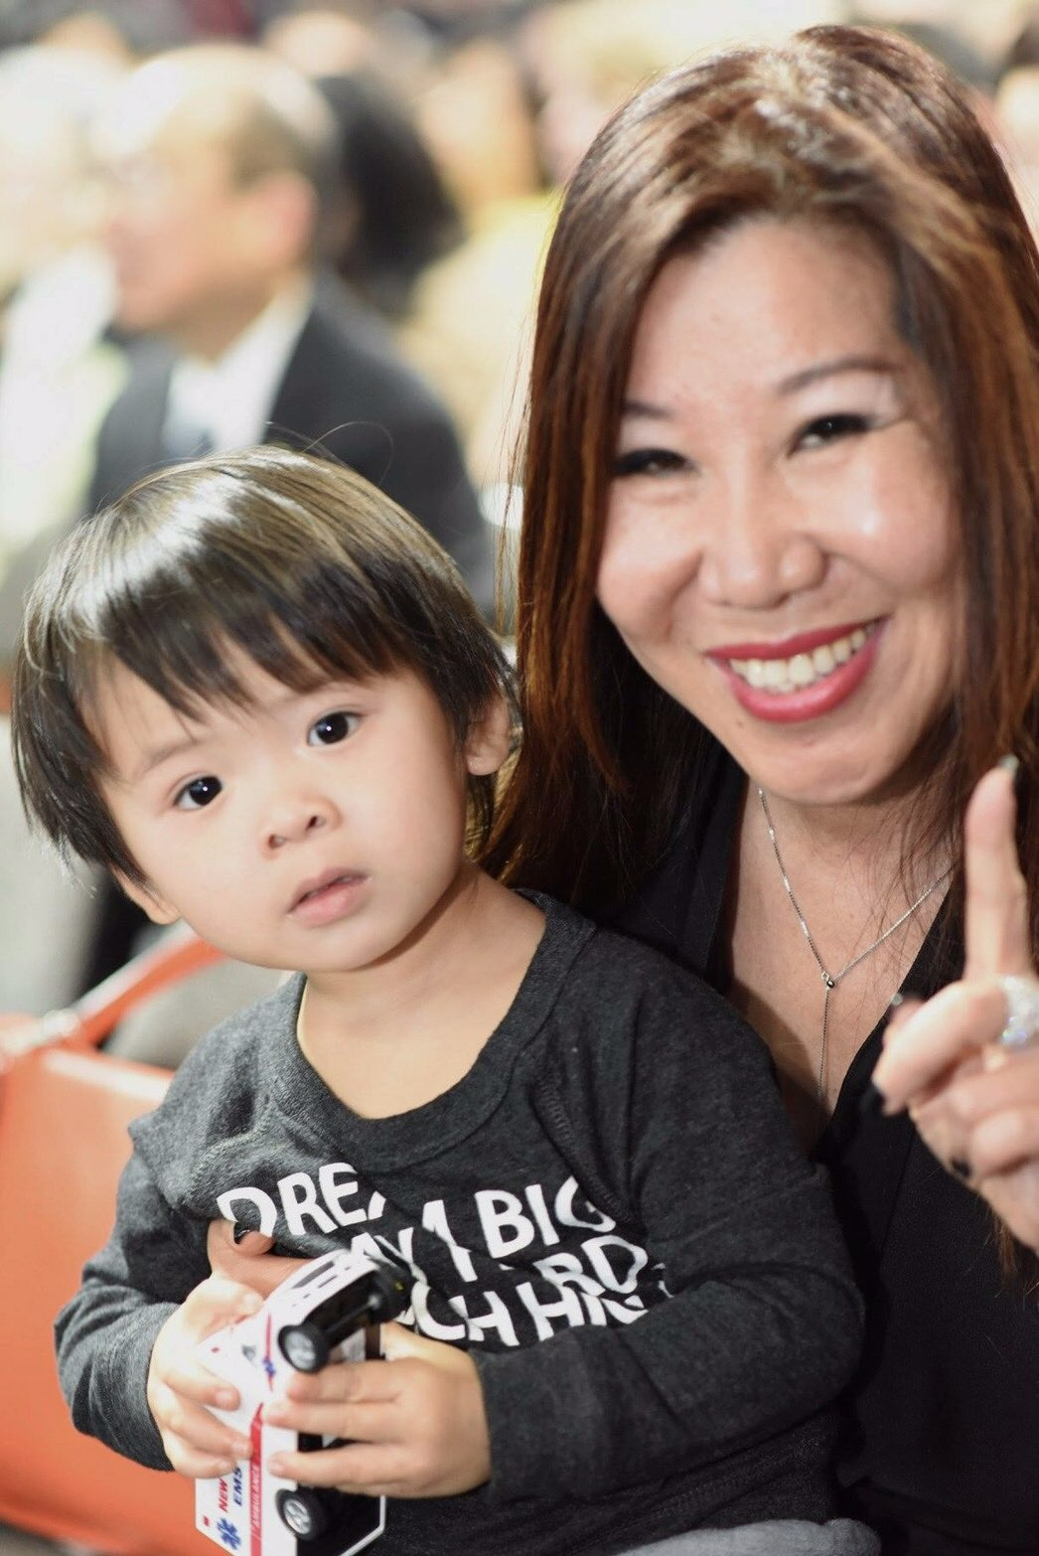
International Field Chairman four-week pay cycle US$125,000 - US$149,000 Joanne Hsi (席再鳳)
THE INCOME LEVELS MENTIONED IN THIS PRESENTATION ARE FOR ILLUSTRATION PURPOSES ONLY. THEY ARE NOT INTENDED TO REPRESENT THE INCOME OF ANY TYPICAL MARKET SINGAPORE ® UNFRANCHISE® OWNER, NOR ARE THEY INTENDED TO REPRESENT THAT ANY GIVEN UNFRANCHISE® OWNER WILL EARN INCOME IN THAT AMOUNT. THE SUCCESS OF ANY MARKET SINGAPORE ® UNFRANCHISE® OWNER WILL DEPEND UPON THE AMOUNT OF HARD WORK, TALENT, AND DEDICATION WHICH HE OR SHE DEVOTES TO BUILDING HIS OR HER MARKET SINGAPORE® BUSINESS.

Slide 9
Self introduction
Born in a military family (foreigner)
Got married after college graduation. Never had any work experience.
Got divorced in 1987 and raised my son by myself
Immigrated to the United States in 1990. Knew little English and had no job
Joined Market America in December, 1995

Slide 10
product + system =
Success of everyone

Slide 11
Now
Product + System
≠
Success of everyone

Slide 12
Determined by PEOPLE

Slide 13
Right person + Product + System
=
Success + Residual Income
Are you the right person?
how to find them?

Slide 14
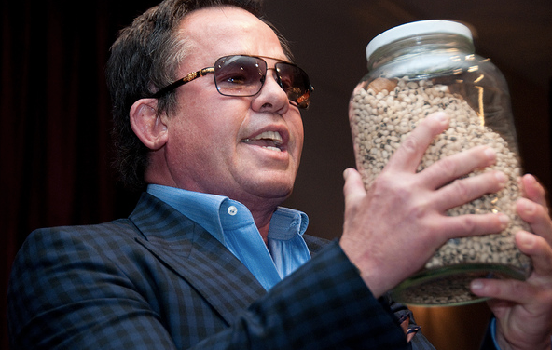
Fill the bean jar
vs.
Shake the bean jar

Slide 15
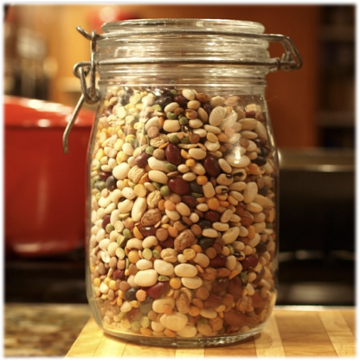
The reason of developing cold market
Fill the bean jar not focusing on a small group of people
Avoid pushy action to increase the base following system everyday 312 1032
Accumulation brings QUALITY and QUANTITY

Slide 16
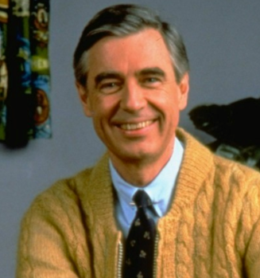
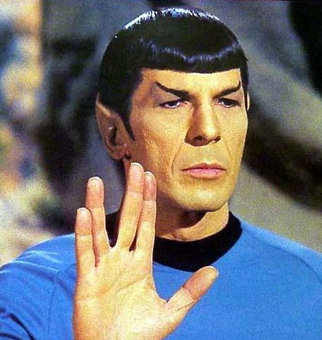
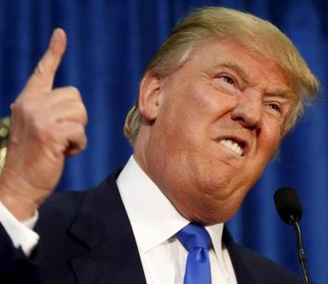
Thoughtful
Active, self-motived
Characters
The Yellows: representative Mr. Rogers ＊Caring ＊Educating people ＊Nurse, teachers, full-time mother taking care of their children ＊Supportig others to reach their target ＊No interest in solving the difficulties of business, but love to help others ＊Overthink, indecisive ＊Reliable ＊High ability to organize ＊Multitasking | The Blues: Representative Cheering team leader ＊Fun and love being with people ＊Adventurous ＊Love making new friends ＊Devote in selling ＊Keep telling stories ＊Refuse to listen to others ＊Fashionable, trendy ＊The soul among a party ＊Not often follow-up ＊They thought they can multitask but they can’t
The greens: representative Spock ＊Engineers, accountants, computer maniac ＊Strong organizer ＊Logical and rational, not emotional at all ＊Get to the bottom of things ＊Study alone ＊Love things which are right ＊It is difficult to pursue the Greens. What you can do is to provide them information and let them study alone | The reds: representative Trump ＊Love bossing people around ＊Strong organizer ＊Always improving ＊Always consider the best proposal to reach a target ＊Focus on the bottom line of limitaton ＊Emphasize on the return on investment ＊Never listen to others because they thought they already know about it ＊All Reds thought they were Yellows ＊Love the right things and competition ＊The Reds know how to earn
With Ideas and effectiveness

Slide 17
The yellows: representative Mr. Rogers
＊Caring
＊Educating people
＊Nurse, teachers, full-time mother taking care of their children
＊Supportig others to reach their target
＊No interest in solving the difficulties of business, but love to help others
＊Overthink, indecisive
＊Reliable
＊High ability to organize
＊Multitasking

Slide 18
The blues: Representative Cheering team leader
＊Fun and love being with people
＊Adventurous
＊Love making new friends
＊Devote in selling
＊Keep telling stories
＊Refuse to listen to others
＊Fashionable, trendy
＊The soul among a party
＊Not often follow-up
＊They thought they can multitask but they can’t

Slide 19
The greens: representative Spock
＊Engineers, accountants, computer maniac
＊Strong organizer
＊Logical and rational, not emotional at all
＊Get to the bottom of things
＊Study alone
＊Love things which are right
＊It is difficult to pursue the Greens. What you can do is to provide them information and let them study alone

Slide 20
The reds: representative Trump
＊Love bossing people around
＊Strong organizer
＊Always improving
＊Always consider the best proposal to reach a target
＊Focus on the bottom line of limitaton
＊Emphasize on the return on investment
＊Never listen to others because they thought they already know about it
＊All Reds thought they were Yellows
＊Love the right things and competition
＊The Reds know how to earn

Slide 21
Thoughtful
Active, self-motived
Characters
The Yellows: representative Mr. Rogers ＊Caring ＊Educating people ＊Nurse, teachers, full-time mother taking care of their children ＊Supportig others to reach their target ＊No interest in solving the difficulties of business, but love to help others ＊Overthink, indecisive ＊Reliable ＊High ability to organize ＊Multitasking | The Blues: Representative Cheering team leader ＊Fun and love being with people ＊Adventurous ＊Love making new friends ＊Devote in selling ＊Keep telling stories ＊Refuse to listen to others ＊Fashionable, trendy ＊The soul among a party ＊Not often follow-up ＊They thought they can multitask but they can’t
The greens: representative Spock ＊Engineers, accountants, computer maniac ＊Strong organizer ＊Logical and rational, not emotional at all ＊Get to the bottom of things ＊Study alone ＊Love things which are right ＊It is difficult to pursue the Greens. What you can do is to provide them information and let them study alone | The reds: representative Trump ＊Love bossing people around ＊Strong organizer ＊Always improving ＊Always consider the best proposal to reach a target ＊Focus on the bottom line of limitaton ＊Emphasize on the return on investment ＊Never listen to others because they thought they already know about it ＊All Reds thought they were Yellows ＊Love the right things and competition ＊The Reds know how to earn
With Ideas and effectiveness

Slide 22
Specify the procedures: Guidance & Conselling
How
To do
What
To do
Start
新人起步
Why
Doing it
Do it
Together

Slide 23
One team One dream

